Slide 1




2023-04-04
I2C 파형 분석

Slide 2

Contents
01
Write
02
Read
03
I2C project

Slide 3
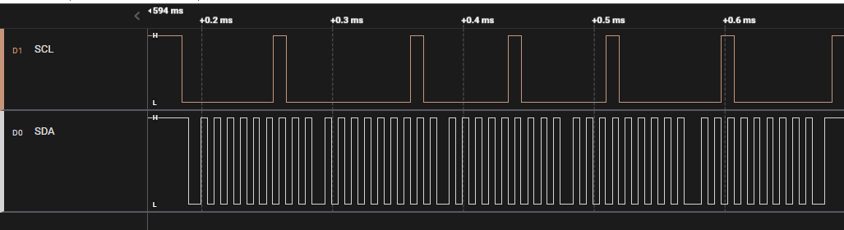
01
Write – 파형 분석
Address(0x01)
ACK
ACK
ACK
ACK
ACK
Start Bit
Write bit
Data Bit(0x01)
Data Bit(0x04)
Data Bit(0x10)
Data Bit(0x20)
Stop Bit

Slide 4
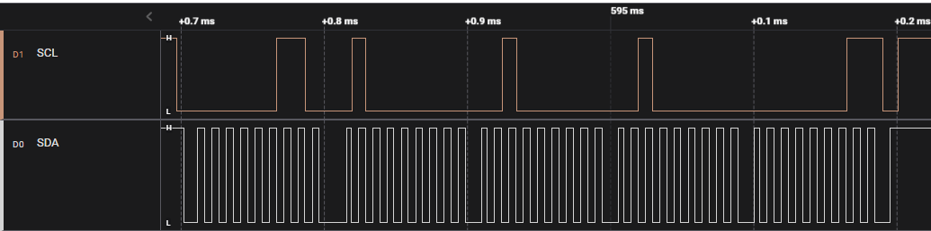
02
Read – 파형 분석
Address(0x01)
ACK
ACK
ACK
ACK
NACK
Start Bit
Read bit
Data Bit(0x40)
Data Bit(0x20)
Data Bit(0x20)
Data Bit(0x01)
Stop Bit

Slide 5
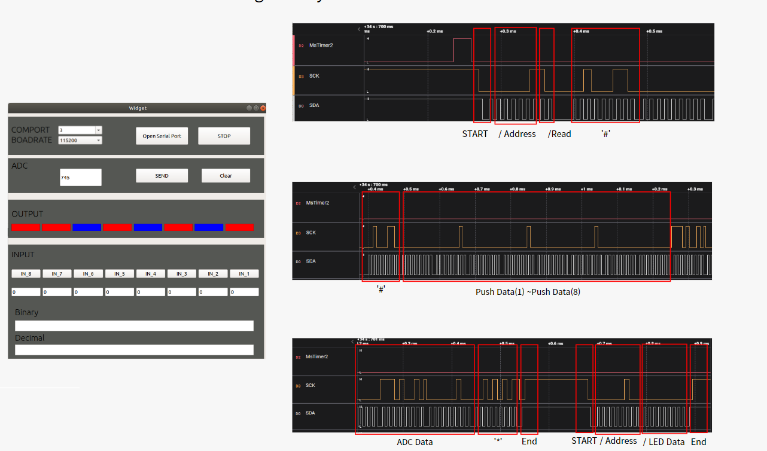
03
I2C project – 파형 분석

Slide 6



